Slide 1
The Problem Solving Process and De Bono’s Hats
A look at broadening one’ s thinking

Slide 2
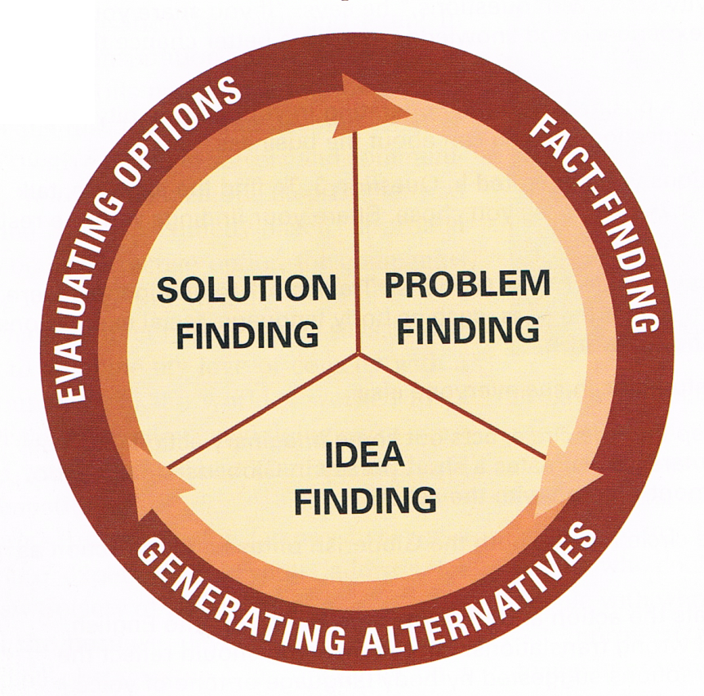
The Problem Solving Process
The problem solving process involves 3 stages:
  Problem Finding
    Try to define the problem by gathering information, observations, feelings, and impressions
  Idea Finding
    try to come up with different alternatives for solving the problem, even the “crazy” ones
  Solution Finding
    Establish a criteria and evaluate the alternatives, choosing the best option

Slide 3
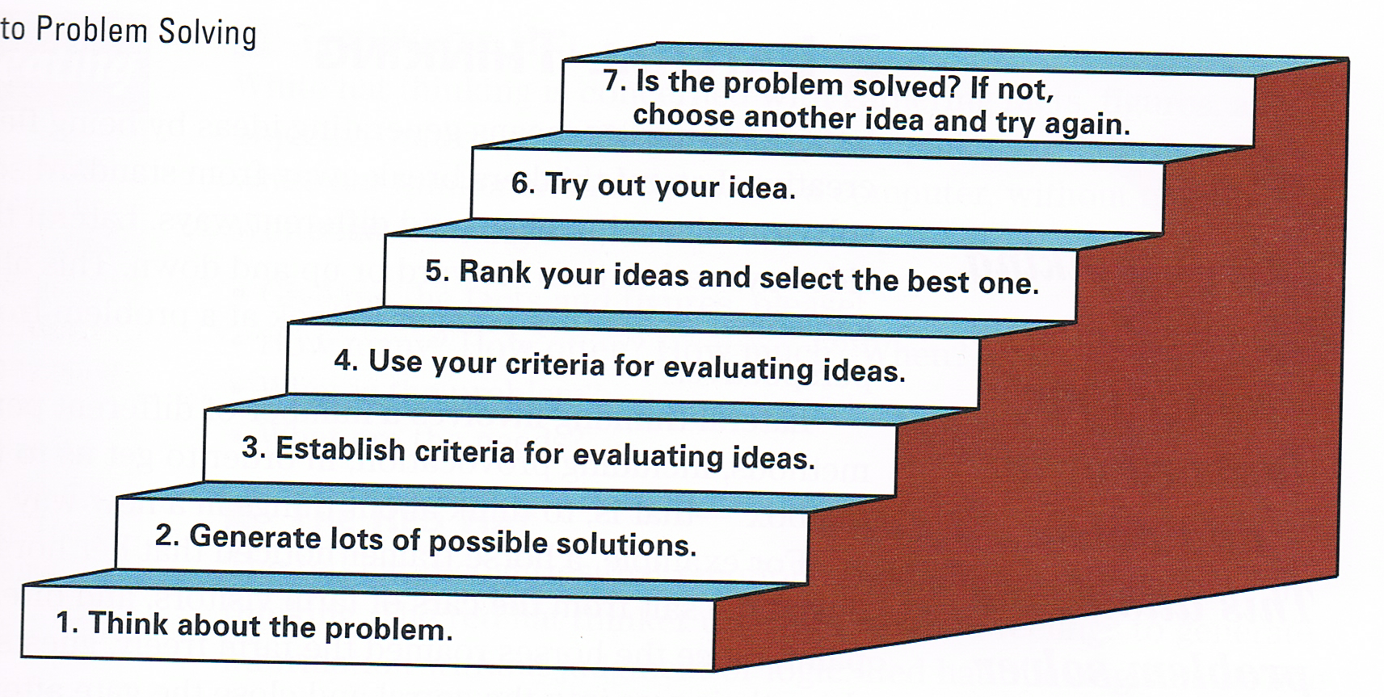
The Steps of Problem Solving

Slide 4
What is Lateral Thinking?
Lateral thinking means generating ideas by being flexible and creative
Lateral thinkers break away from standard solutions and solve problems in unique and different ways
This is most commonly known as “thinking outside the box”

Slide 5
Why look at DeBono’s hats?
The whole point of the method is that the human brain thinks in a number of distinct ways
  If these ways can be identified and deliberately used, it can allow someone to develop strategies for thinking about particular issues
  Broadens the scope of thought
By mentally wearing and switching "hats," you can easily focus or redirect thoughts, conversations, or meetings

Slide 6
DeBono’s Six Hats
Black-Negative feedback
Green-Nature/creativity
Red-Emotion/intuition
White-Gathering facts
Yellow-Logic/positive
Blue-Organizes/Controls

Slide 7
De Bono – Black Hat
Negative Feedback; Critical logic; no emotion
Sounds Like: “It won’t work; this could be a problem”
Always looking for the problem(s) in the idea

Slide 8
De Bono – Green Hat
Represents nature and things that grow from seeds - creativity
Sounds Like: “Aha; eureka; how else could we do this?”
Similar to Green in True Colours, always looking for ways to improve the idea

Slide 9
De Bono – Red Hat
Recognizes that emotion and feeling influence decisions
Sounds like: “I have a hunch; this is how I feel about”
Uses emotions to determine how others will “react” to product

Slide 10
De Bono – White Hat
Gathering Facts, acquiring information
Sounds like: “Just the facts ma’am”
Simple data collection without making judgment calls

Slide 11
De Bono – Yellow Hat
Positive Feedback; Constructive logic
Sounds like: “I want to explore this further; this idea has value”
Rather than looking for the problems (black), looking for ways to further develop the idea

Slide 12
De Bono – Blue Hat
Organizes, Controls and Leads
Sounds like: “Focus; Lets get started: Your turn”
Involved with the implementation of the idea, the “nuts and bolts” of it

Slide 13
Placing the Hats in the Creative Problem Solving Process
Problem Finding
Red & White Hat
4. Action
Blue Hat
2. Idea Finding
Green Hat
3. Solution Finding
Black & Yellow Hat

