Slide 1
Introduction to MS Word
What is it and Why use it?

Slide 2
What is MS Word?
MS Word is a word processor developed by Microsoft
Word Processor - an electronic device or a computer software application that, as directed by the user, performs word processing: the composition, editing, formatting and sometimes printing of any sort of written material
Microsoft estimates that over 500,000,000 people use the Microsoft Office suite

Slide 3
Text Documents
The vast majority of documents used by businesses would be considered text documents, consisting of basic graphics and obviously text
Initial word processing software replicated the typewriter by only providing a basic font and size
As technology increased, numerous fonts and graphics became available and were added to enhance the appearance of these documents

Slide 4
MS Word and File Extensions
Depending on the type of file you are looking at, it will have an extension added to the end of it
MS Word has the extension “ .docx” on the end
Older MS Word versions used the extension “.doc”, with the x being added in the 2010 version of the software
Other brands will have different extensions (e.g. Corel WordPerfect used “.wpd”

Slide 5
Using the Tabs in MS Word
Microsoft Office products have implemented a tab system for navigating through the software
Depending on what you are looking for, it will be listed under the appropriate tab

Slide 6
What is a Font?
A font is a complete set of characters in a specific face, style and size. Each set includes upper and lowercase letters, numerals and punctuation.
Here are some examples of different fonts
Here are some examples of different fonts
Here are some examples of different fonts
Here are some examples of different fonts
Here are some examples of different fonts
Here are some examples of different fonts

Slide 7
Font Face
There are three types of font faces: serif, sans serif and script.
Serif - has lines, curves or edges extending from the ends of the letters. It is typically used for document text because it is more readable.
Sans serif - “San serif” means without serifs or “tails.” It is often used for headlines or technical material.
Script - looks like handwriting. Script typefaces are used for formal invitations and announcements

Slide 8
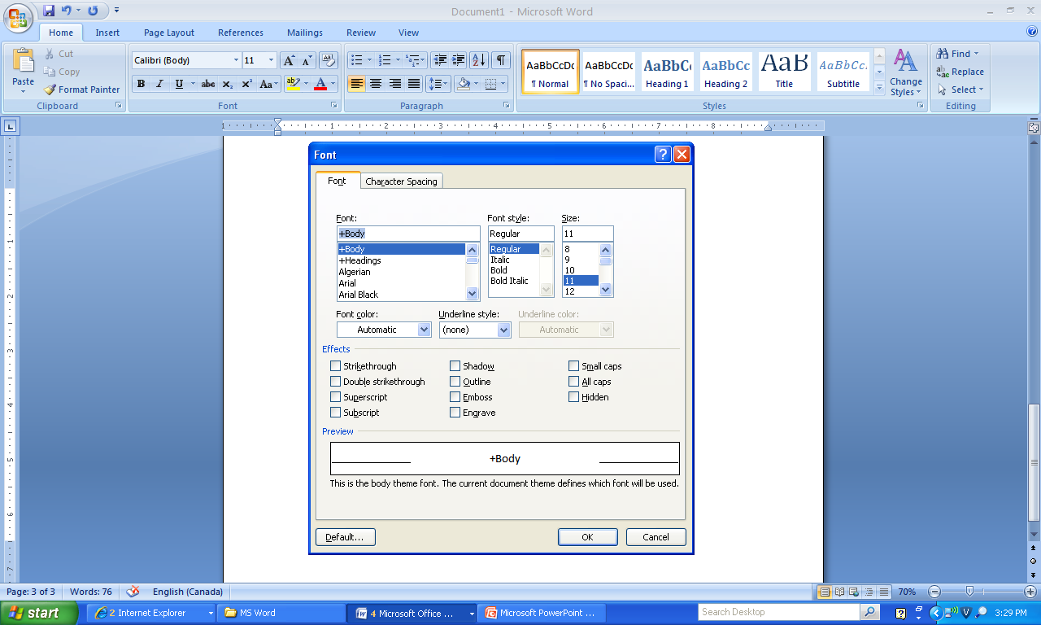
The Font Tool
This menu lets you change the font face, size, style, colour, appearance and/or position

Slide 9
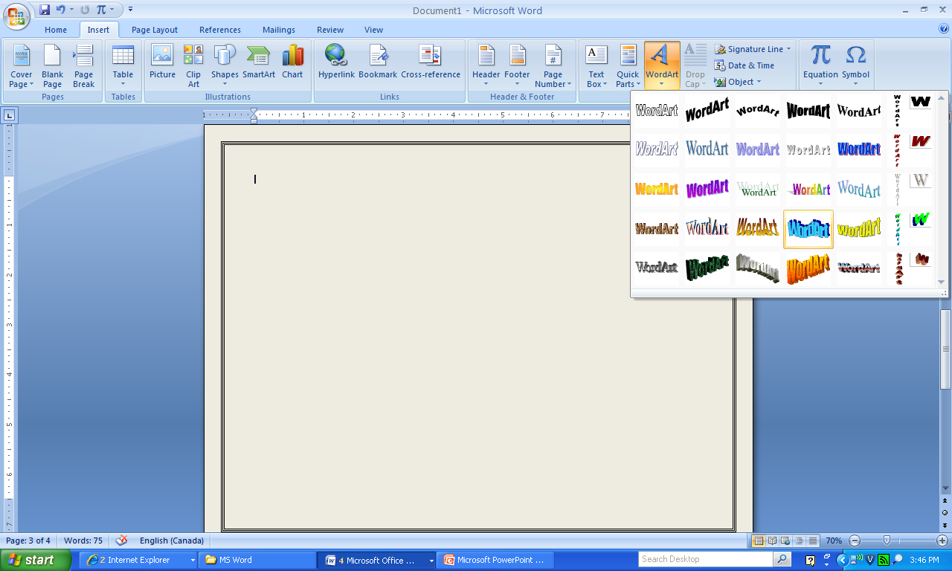
Word Art
You can also use a feature called WordArt to design stylized letters in your document
Access it through the Insert tab -> Word Art
It will bring up a new format tab where you can customize your design
Like this
Or This
Or This

Slide 10
Page Colours
You can change the background colour of your word document in 2 ways
Change the colour of the paper you are printing it on
Change the actual background on the document
This can be beneficial for people who have difficulties reading / seeing black text on a white background
Under the Page
Layout tab

Slide 11
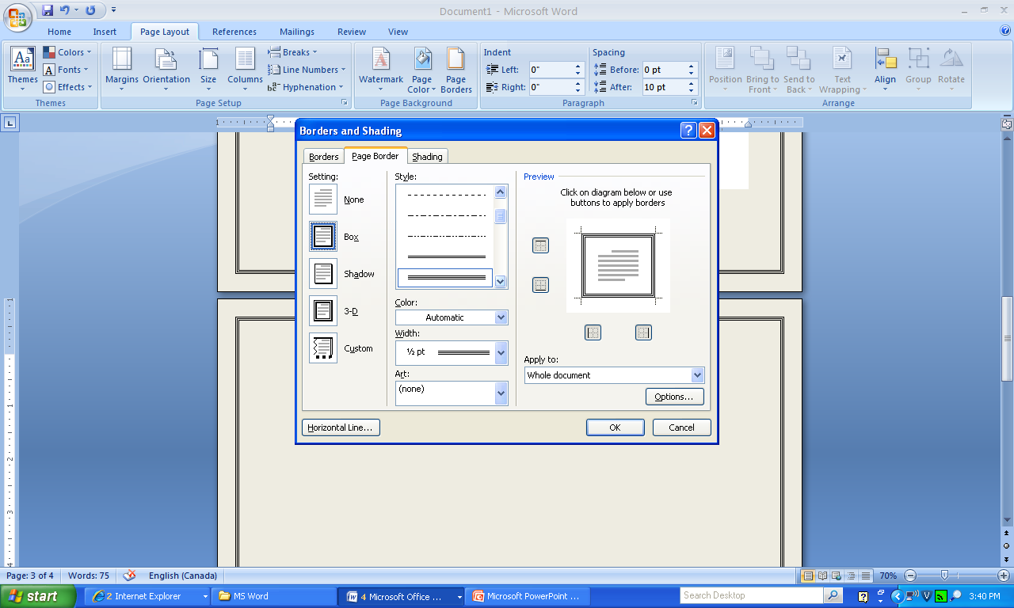
Adding a Border
Depending on the type of document, you may wish to add a border around your page
You can add
numerous types
of linear or
photo borders
through the
menu

Slide 12
Your Task
Complete MS Word Tutorials #1 & 2
They are located on the X Drive and on the course website

